Slide 1
Accreditation Process 2023-24
Small Schools
Deep Dive
Office of Public Instruction Staff
November 2023

Slide 2
Agenda
Welcome/Introductions
Year 1 Plan
Criteria Reference Guide
Accreditation Platform Template
CNA & Gap Analysis
Identifying Root Cause
Goal Setting
Building Action Plans
Where to Start?
Professional Development
How to Connect with Us?

Slide 3
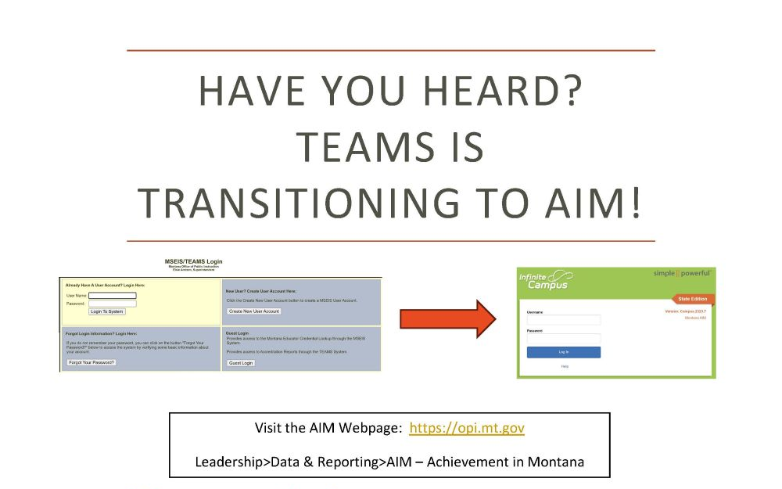
Visit the AIM Webpage for more information

Slide 4



Welcome/Introductions
Crystal Andrews
Director of Accreditation, Educator Preparation Programs, & Licensure
Ellery Bresler
Accreditation
Specialist
Michelle Price
Accreditation
Specialist

Slide 5
Year 1- All Districts
Year 1- “Coach and Guide”
Focus on Support, Mechanisms and Methodology
Due: March 29th, 2024
ISAP Components | Assurance Standards | Student Performance Standards
CNA with Gap Analysis to set goals and academic programming Family and Community Engagement Plan Graduate Profile- a plan to show progress (2-3 action steps to meet graduate profile) no set template - districts have flexibility to individualize | General Assurances: School Leadership Academic Requirements | Proficiency, Progress and Growth: SBAC MAPS I-Ready STAR Dibels *A valid and reliable assessment the district is already using. * MAST Pilot cannot be used as it is a pilot program.
Notes:
Student Performance Standards Data Tools are examples only. Use the assessment tool that fits your district’s needs.

Slide 6
Criteria Reference Guide in Rule
10.55.606 ACCREDITATION PROCESS
(1) Regular accreditation means the school has met the assurance standards and student performance standards as defined in ARM 10.55.606, and the Licensure Endorsement Requirements Related to Teaching Assignments. A copy of the Accreditation Status Criteria Reference Guide must be made publicly available by the Superintendent of Public Instruction.
(2) Regular with minor deviation accreditation means the school does not meet all the requirements of regular accreditation outlined in (1), as defined in the Accreditation Status Criteria Reference Guide, which must be made publicly available by the Superintendent of Public Instruction.
(3) A school with regular accreditation with a deviation in student performance standards, as defined in ARM 10.55.606, or regular with minor deviations accreditation, as defined in ARM 10.55.606, shall remedy the deviations within three years or will be reassigned to a lower category of accreditation.
(4) Advice accreditation means the school exhibits serious and/or numerous deviations from the standards. A copy of the Accreditation Status Criteria Reference Guide must be made publicly available by the Superintendent of Public Instruction.
(5) Deficiency accreditation means the school is in advice status for two years, has not complied with the required corrective plan, and continues to have serious and/or numerous deviations, or has substantially increased the seriousness of deviations over the previous year.
Notes:
Rubric based accreditation
Regular accreditation
Regular with minor deviation
*Regular with deviation Student Performance or RMD need to remedy within 3 yrs or will reassign to lower accreditation
Advice accreditation
Deficiency accreditation
One area won’t necessarily cause deficiency for entire accreditation status

Slide 7
Criteria Reference Guide
This is what will be used for year 1 accreditation
Year 2 will look different and will be coming at a later date.
Accreditation Process website for updates and guidance documents
Notes:
Final Draft CRG
CRG Checklist

Slide 8
Accreditation Platform Template
This is going to be used to create the accreditation platform.
You will submit your work through the Accreditation Platform, we will be assessing your accreditation status using the criteria reference guide.
ISAP Template
Criteria Reference Guide

Slide 9
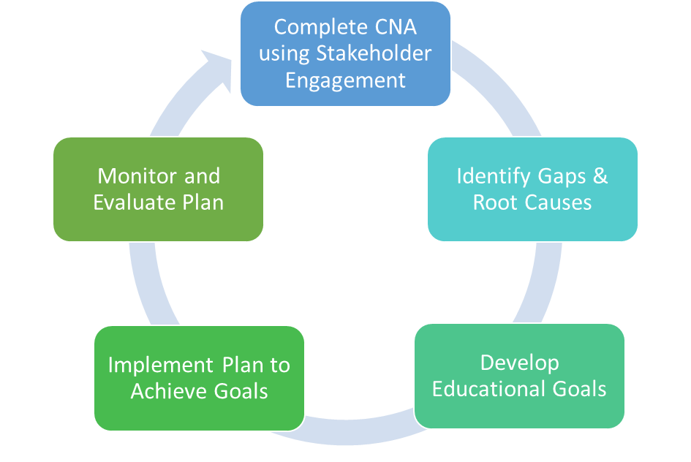
Improvement Cycle

Slide 10
CNA & Gap Analysis
Comprehensive needs assessment in Rule:
a comprehensive needs assessment as defined in ARM 10.55.602(8) “...a process that is used to identify district and school area(s) of need, the root causes of identified gaps, set priorities, and inform an action plan for improvement;
10.55.601(3) “To ensure a learner-centered system and establish a plan for continuous education improvement, the school district shall develop, implement, monitor , and evaluate an integrated strategic action plan and make the plan publicly available. To align with local context and needs, the district integrated strategic action plan shall be updated at least every three years based on a comprehensive needs assessment with meaningful stakeholder input and feedback that comply at a minimum, with applicable requirements in Title 2, chapter 3 , part 1 MCA. The plan must clarify what specific steps must be taken to achieve the district graduate profile and reflect a continuous improvement process.”

Slide 11
CNA & Gap Analysis
Areas to include
Process Data: enrollment, demographics, attendance rates, student to teacher ratios, services, engagement, etc.
Perspective Data: CNA survey results from stakeholder groups
Performance Data: state mandated testing, universal screeners, district assessments
CNA Data Analysis Template
Notes:
CNA Data Analysis Template
One Room Schoolhouse: may not have every area filled out in template, community input is essential since the school is the center of the community culture

Slide 12
Identifying Root Cause
Tips for Identifying Root Cause
Complete in stages if possible
Involve representatives from stakeholder groups
Be task oriented
Filter out contributing causes using a process such as 5 Whys, Fishbone, Circle Mapping
Guide to Identifying Root Cause
5 Whys
Fishbone Method
Notes:
Identifying Root Cause 5 Whys Fishbone Method
One Room Schoolhouse: may want to consider input from other small schools; try to include board members

Slide 13

SMART Goals
Notes:
SMART Goals Worksheet

Slide 14
Building an Action Plan
Be specific when stating your desired outcome
Select strategies and tools that are feasible for your district
Identify funding and/or resources; might include those already in place
Identify and involve key people responsible for monitoring implementation, progress, and outcomes
Strategic Action Template
Notes:
Strategic Action Plan Template
Small Schools may need to consider cooperatives as resources

Slide 15
Where to Start?
Comprehensive Needs Assessment
Analyze CNA Results/Find Root Causes
Create SMART GOALS (Specific, Measurable, Attainable, Relevant, Time-Bound)
Create Action Plans
Gather Current Student Performance Information
Start Graduate Profile
Continually Collect Throughout Year - Recommend to start ASAP
Indian Education for All programming
Family and Community Engagement

Slide 16
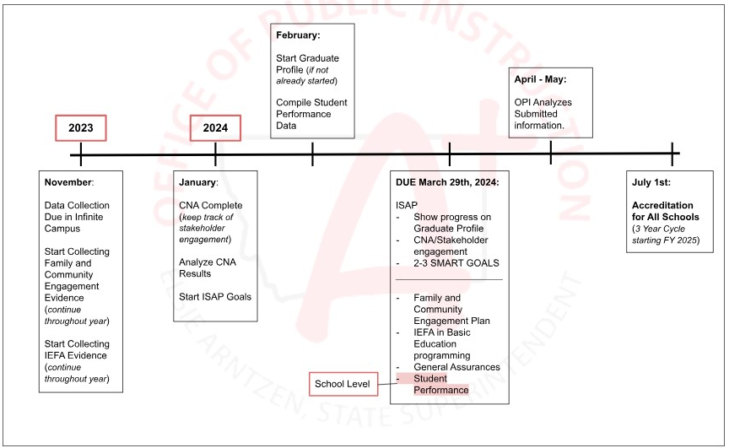
Suggested Timeline to Submission

Slide 17
Professional Development
NOVEMBER
13th 12:00- 3:00 | Indian Education for All & Student Performance | Hybrid Session (Helena/Virtual)
29th 1:30- 3:00* | Graduate Profile | Virtual
JANUARY
25th TBD | Family and Community Engagement | Virtual
FEBRUARY
1st 12:00- 1:30 | The New Accreditation Tool | Virtual
2nd 9:00- 10:30
20th- 22nd 9:00- 12:00 & 1:00- 4:00 | Work Sessions | Virtual
26th 9:00- 3:00 | Work Session | Billings
28th TBD | Work Session | Missoula
29th 9:00- 3:00 | Work Session | Helena
MARCH
1st TBD | Work Session | Havre

Slide 18
How to Connect with Us?
Virtual Office Hours via Zoom
  Tuesdays 3:00 - 4:00
  https://mt-gov.zoom.us/j/85904973164?pwd=V2JGbGFoNE1rVmx3Z29mVUJwKy9xdz09
Professional Development Sessions
  See previous slide
Email
  OPIACCRED@mt.gov
Webpage
  https://opi.mt.gov/Leadership/Assessment-Accountability/School-Accreditation
Notes:
Show Webpage https://opi.mt.gov/Leadership/Assessment-Accountability/School-Accreditation
Demonstration Example: Demonstration Example

Slide 19
Questions?

Slide 20

The End

